Slide 1
PLANETARY HEALTH
AN INTRODUCTION

Slide 2
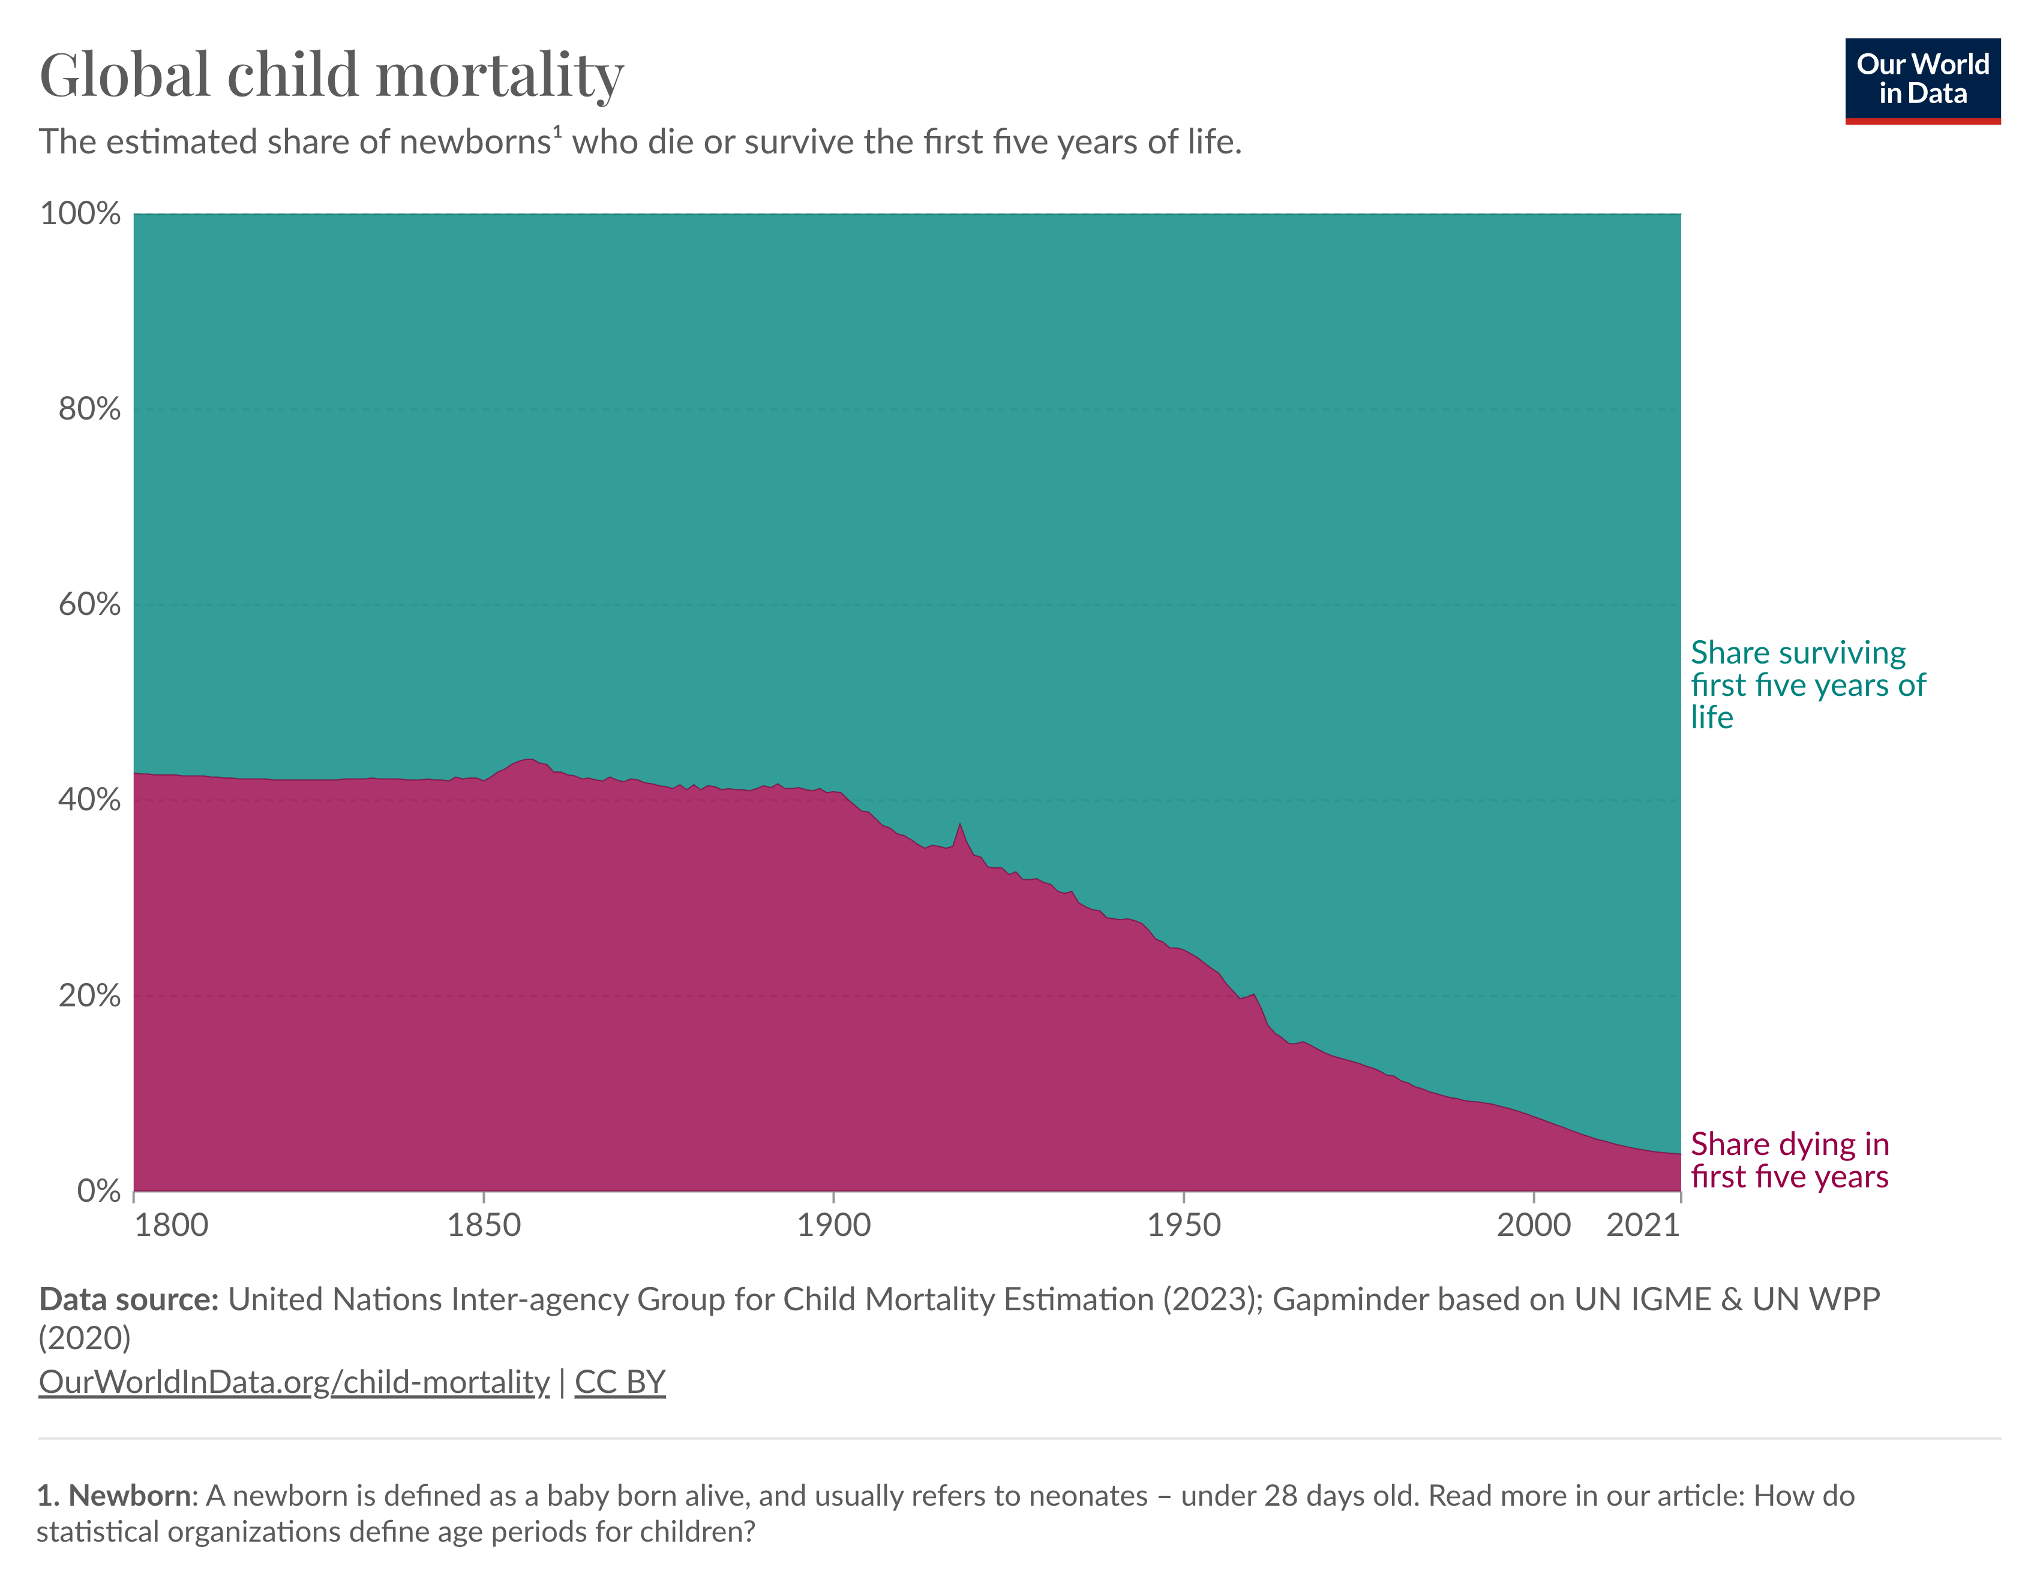
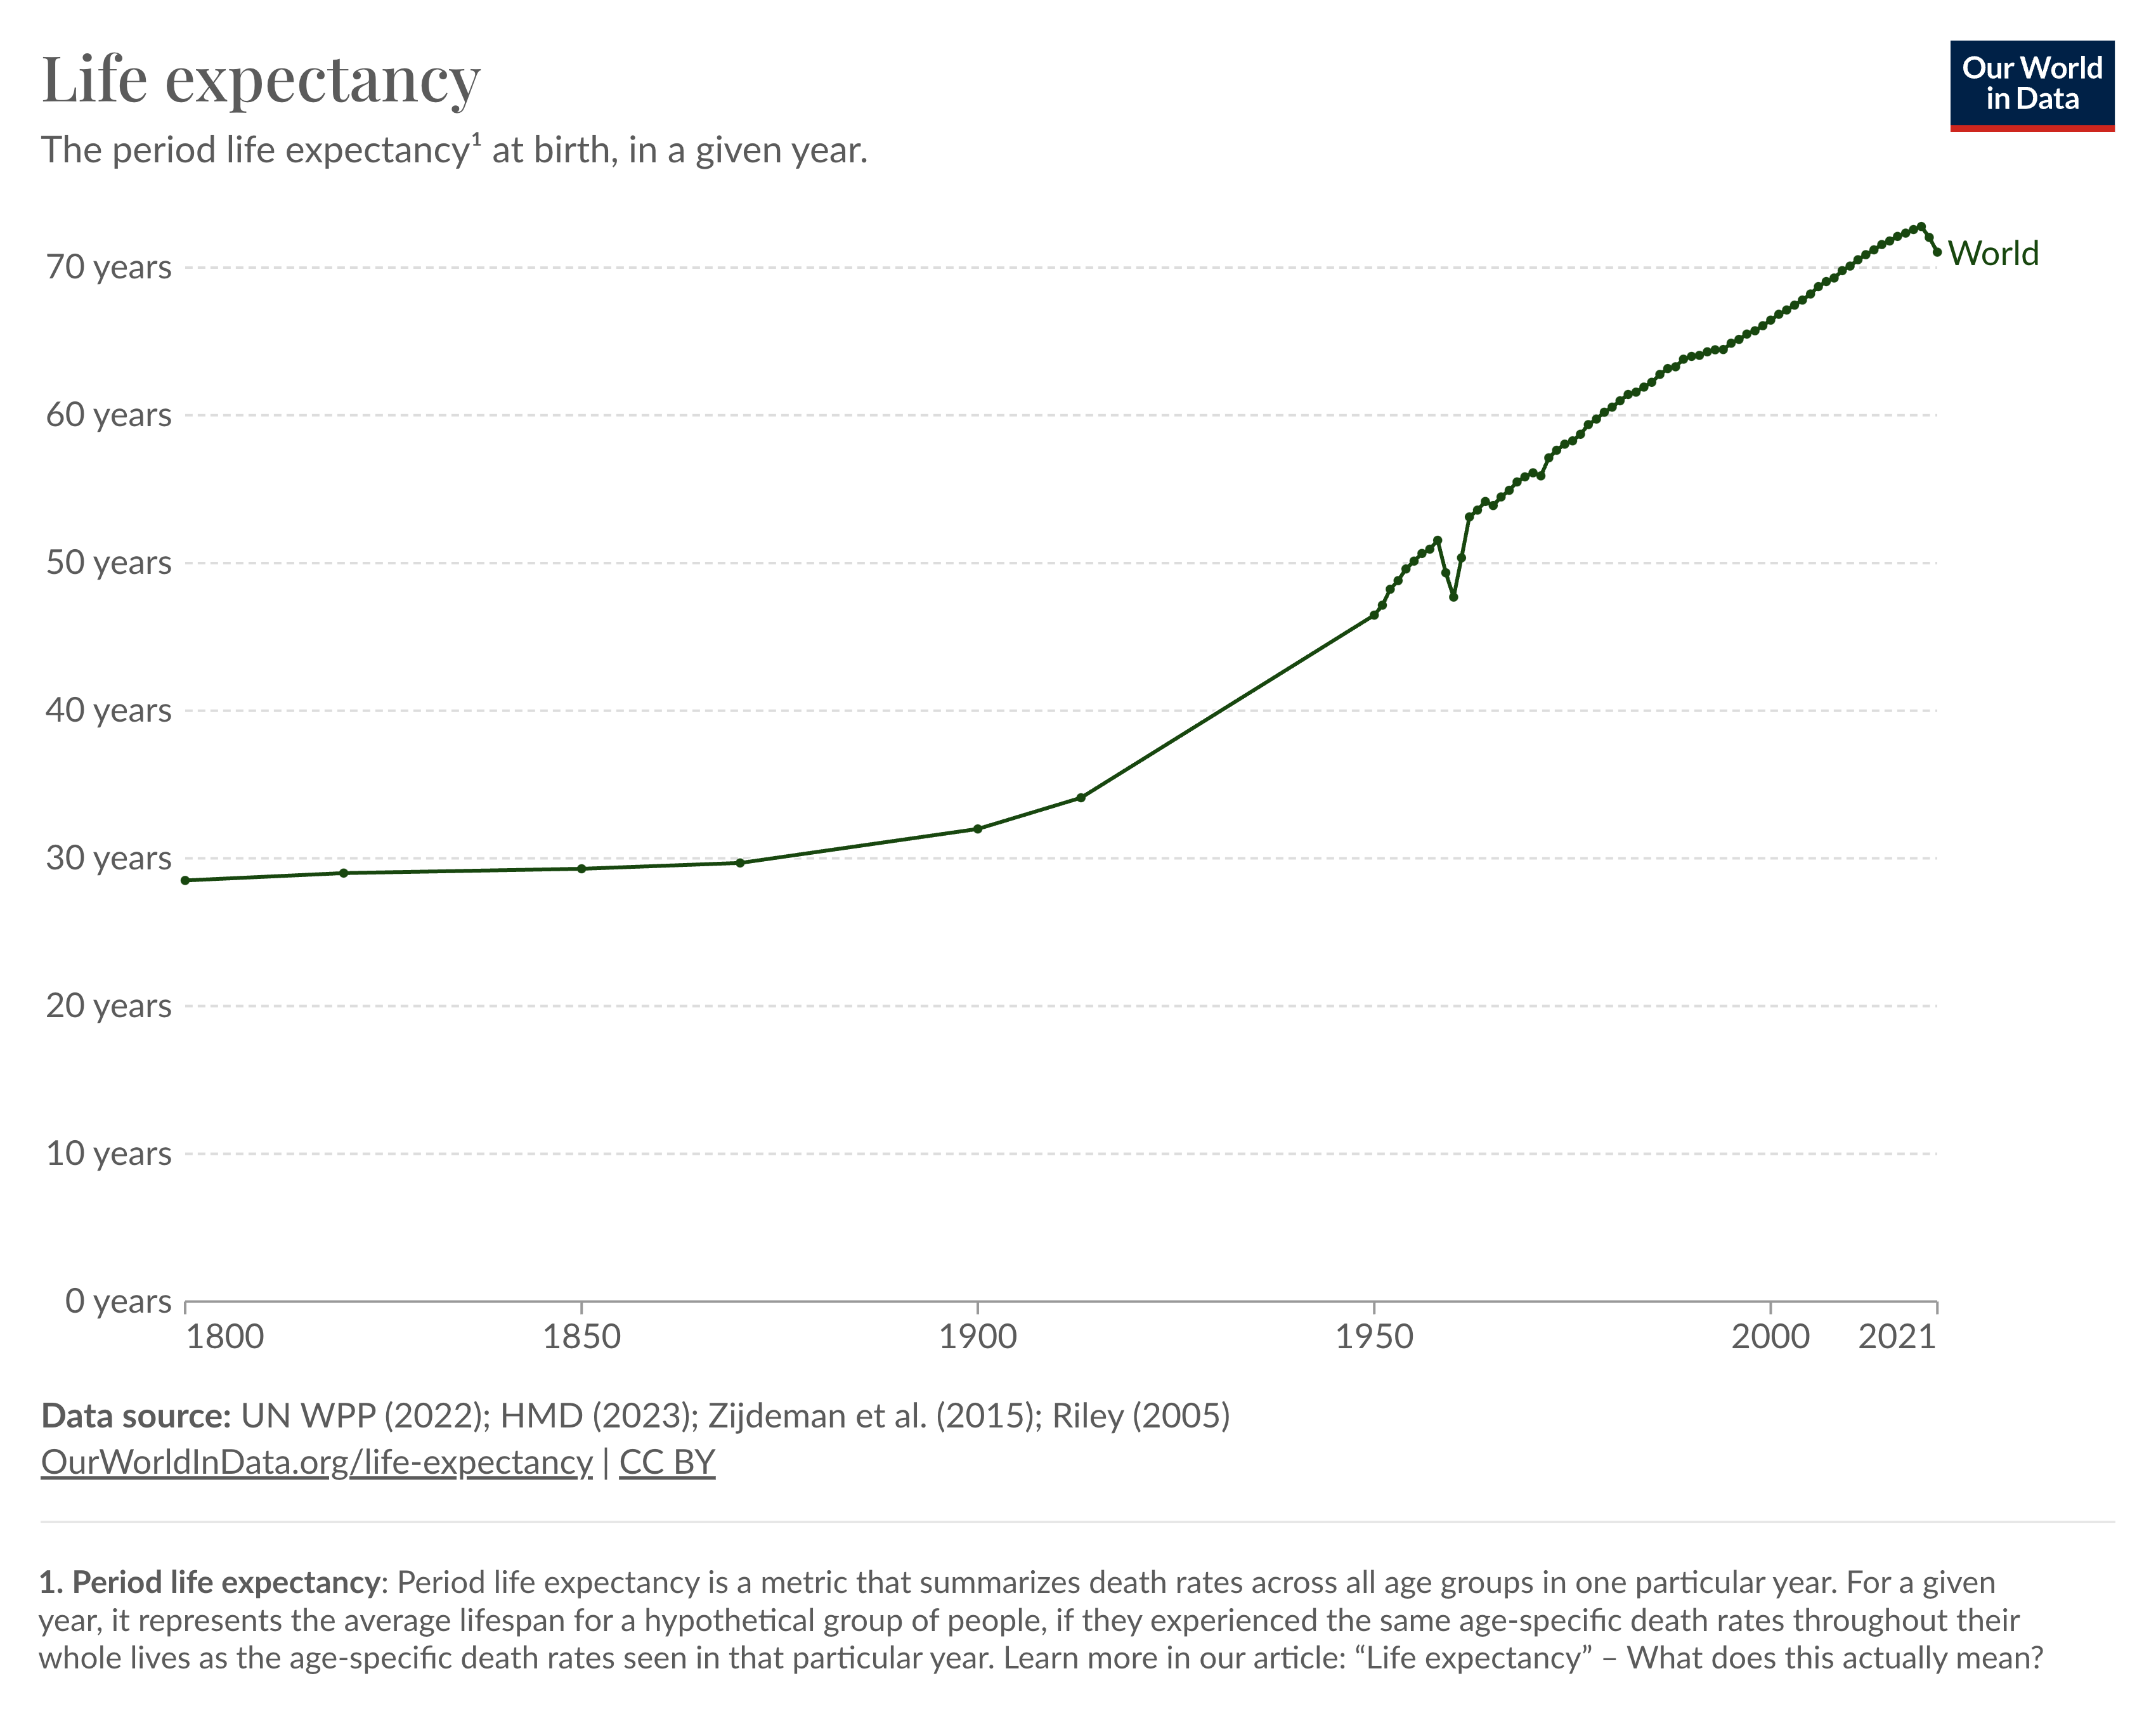
Human Development
Over the past century, humanity has made tremendous public health gains by traditional measures such as decreasing global child mortality and increasing life expectancy

Slide 3
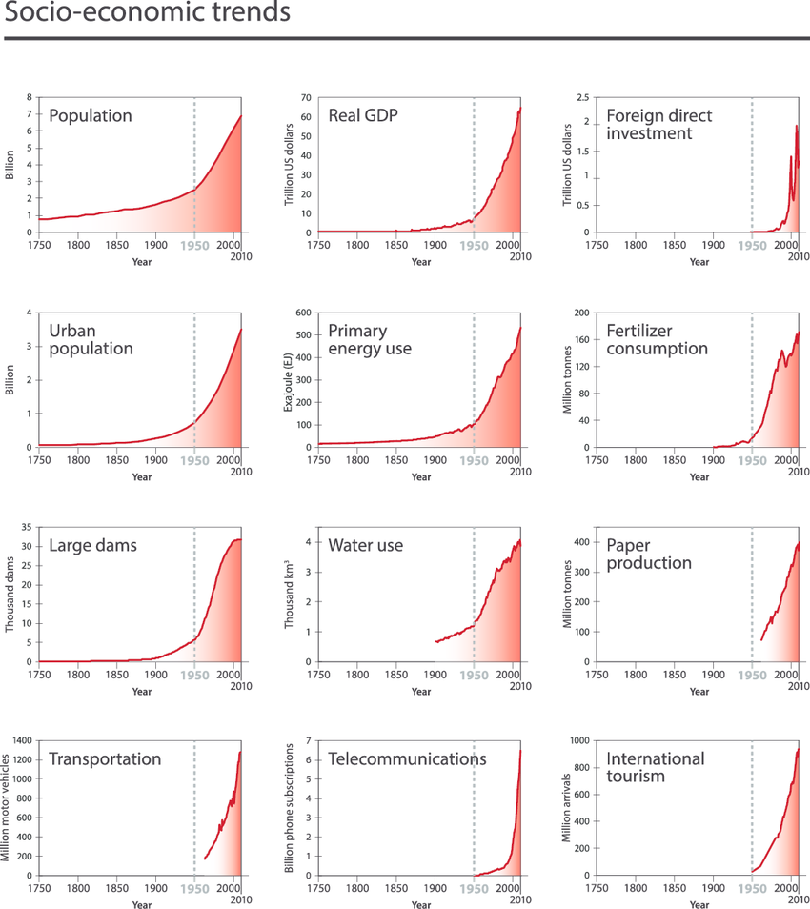
ç
The Great Acceleration
Since 1950 consumption patterns have increased exponentially
Steffen, Will, et al. "The trajectory of the Anthropocene: the great acceleration." The Anthropocene Review 2.1 (2015): 81-98.
Notes:
Those gains in human health along with new and improved technologies and an increase in human population have also led to The Great Acceleration – where we see nearly exponential increases in the use of freshwater resources, the proliferation of motor vehicles, consumption of fertilizers, production of paper or plastics, or primary energy use​
​
These graphs show the scale of human consumption all reveal a similar, nearly exponential pattern over the past several decades.​
​
Converted 40% of land surface for croplands and pasture
Appropriate about half accessible fresh water for human uses
90% of monitored fisheries at, or beyond, limits
Cut down 7-11 million km2 of forests
Dammed 60% of rivers
Growing air, water and land pollution
Climatic Disruption
Species loss 1000 times baseline rate
Population sizes of mammals, fishes, birds, reptiles and amphibians reduced by 66% since 1970
Roughly 1 million species facing extinction, many within decades
Perhaps not surprisingly, this “great acceleration” has led to what Gus Speth has called “the great collision” between humanity and Earth’s natural systems. Driven by rapid increases in global human population and even steeper growth in per capita consumption, the scale of human impacts on our planet’s natural systems is hard to overstate: To feed ourselves, we annually appropriate about 40% of the ice-free, desert-free terrestrial surface for pastures and croplands4, we use about half the planet’s accessible water, largely to irrigate our crops2, and we exploit 90% of global fisheries at, or beyond, their maximum sustainable limits5. In the process, we have cut down 7-11 million km2 of the world’s forests6 and dammed over 60% of its rivers7. The quality of air, water, and land is diminishing in many parts of the world because of increasing global pollution8. These and other processes are driving species extinct at roughly 1000 times baseline rates9 while reducing population sizes of mammals, fishes, birds, reptiles, and amphibians by half over the past 45 years10.

Slide 4
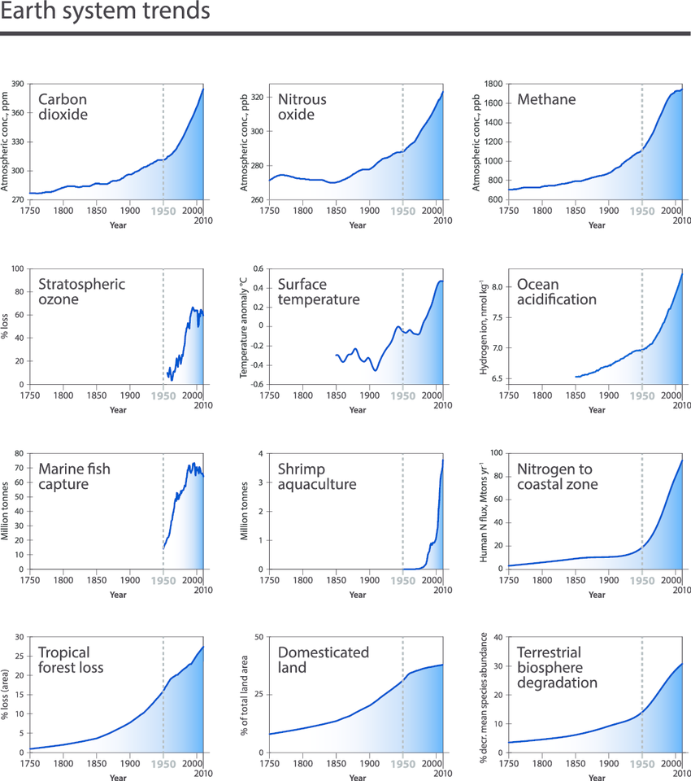
The Great Acceleration
At the same time, we have disrupted Earth's natural systems
Steffen, Will, et al. "The trajectory of the Anthropocene: the great acceleration." The Anthropocene Review 2.1 (2015): 81-98.
Notes:
Those gains in human health along with new and improved technologies and an increase in human population have also led to The Great Acceleration – where we see nearly exponential increases in the use of freshwater resources, the proliferation of motor vehicles, consumption of fertilizers, production of paper or plastics, or primary energy use​
​
These graphs show the scale of human consumption all reveal a similar, nearly exponential pattern over the past several decades.​
​
Converted 40% of land surface for croplands and pasture
Appropriate about half accessible fresh water for human uses
90% of monitored fisheries at, or beyond, limits
Cut down 7-11 million km2 of forests
Dammed 60% of rivers
Growing air, water and land pollution
Climatic Disruption
Species loss 1000 times baseline rate
Population sizes of mammals, fishes, birds, reptiles and amphibians reduced by 66% since 1970
Roughly 1 million species facing extinction, many within decades
Perhaps not surprisingly, this “great acceleration” has led to what Gus Speth has called “the great collision” between humanity and Earth’s natural systems. Driven by rapid increases in global human population and even steeper growth in per capita consumption, the scale of human impacts on our planet’s natural systems is hard to overstate: To feed ourselves, we annually appropriate about 40% of the ice-free, desert-free terrestrial surface for pastures and croplands4, we use about half the planet’s accessible water, largely to irrigate our crops2, and we exploit 90% of global fisheries at, or beyond, their maximum sustainable limits5. In the process, we have cut down 7-11 million km2 of the world’s forests6 and dammed over 60% of its rivers7. The quality of air, water, and land is diminishing in many parts of the world because of increasing global pollution8. These and other processes are driving species extinct at roughly 1000 times baseline rates9 while reducing population sizes of mammals, fishes, birds, reptiles, and amphibians by half over the past 45 years10.

Slide 5
The Ecological Paradox
The state of human health and that of our planet’s natural systems have been trending in opposite directions.
Human Health & Well-Being
Ecological Health & Well-Being
Myers, 2017

Slide 6
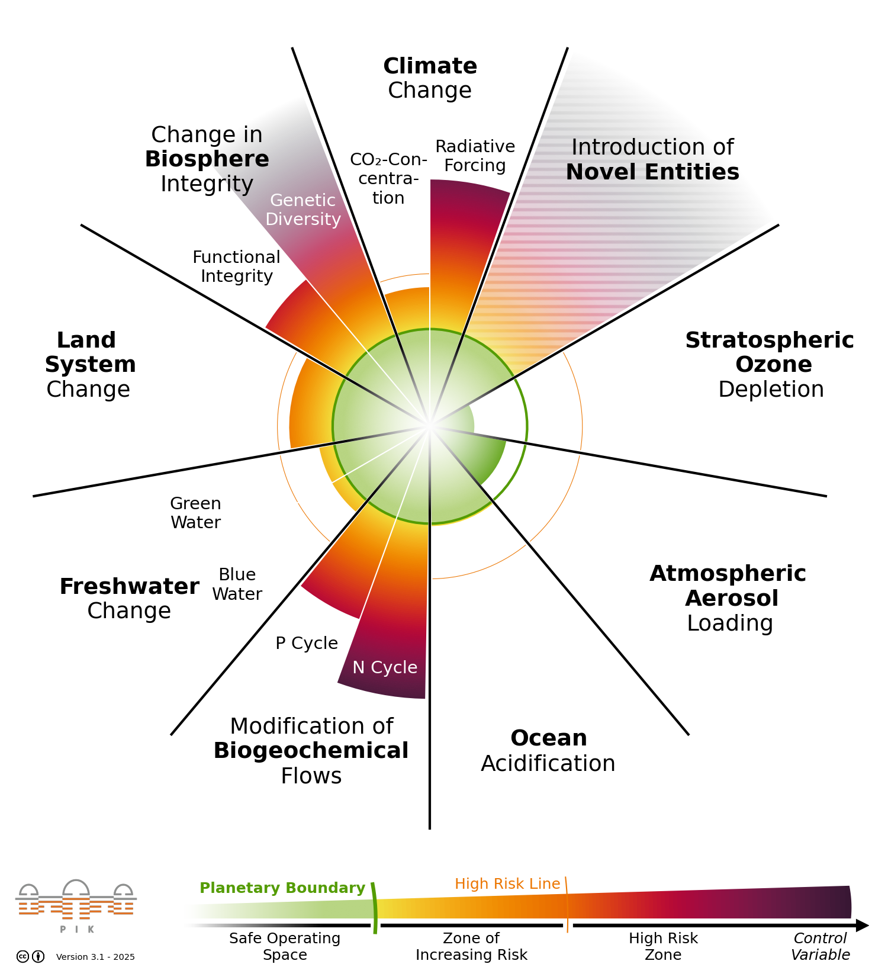
The Planetary Boundaries
The Planetary Boundaries track how human activity is affecting nine critical processes that keep our planet stable.
Today, seven of the nine boundaries have been crossed, threatening the stability of the natural systems that sustain life.
  Climate change​
  Loss of biosphere integrity​
  Land-system change ​
  Altered biogeochemical cycles
  Freshwater change
  Novel entities
  Ocean Acidification
  Atmospheric Aerosol Loading
  Stratospheric Ozone
The current status of the nine Planetary Boundaries, based on the Planetary Health Check 2025. This visualization was published by PIK under the CC-BY license. Figure version 3.1 (2025).

Slide 7

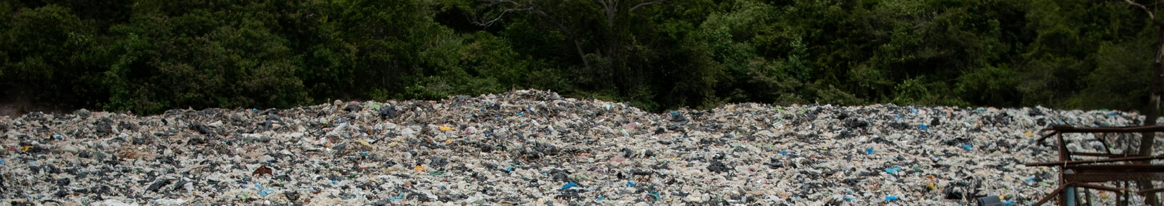
More than just climate change,
we are facing an everything change.

Slide 8
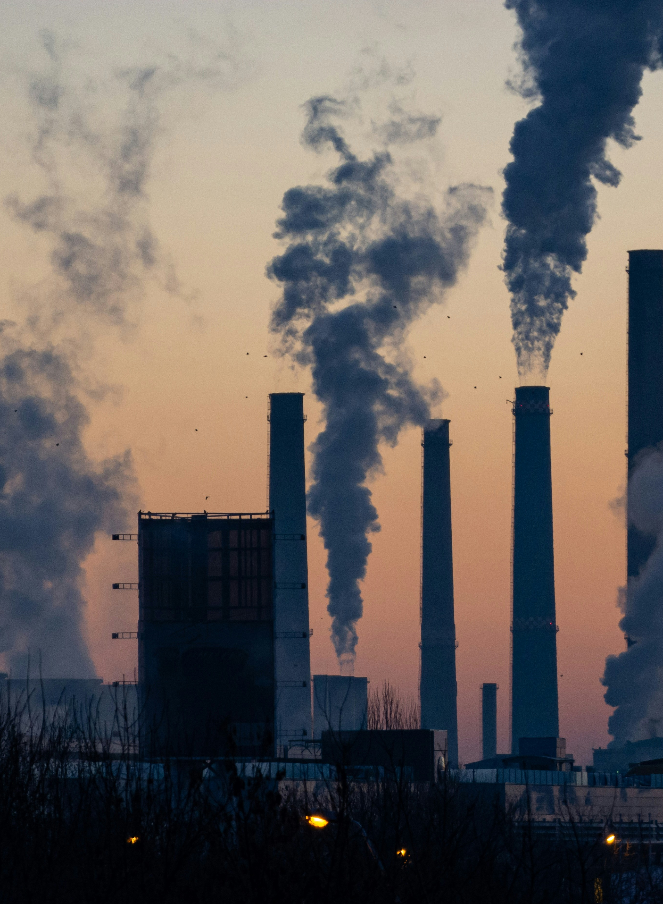
These human-driven environmental changes jeopardize decades of public health gains
Human health impacts include, but are not limited to:
Antimicrobial resistance
Toxin and dioxin exposures
Malnutrition
Heat stroke
Cardiovascular disease
Respiratory diseases, like asthma and COPD
Mental health impacts
Civil strife and trauma
Changing patterns of infectious disease transmission
Forced displacement and migration
Notes:
What does all this environmental change mean in terms of human health?
Well, it severely affect our health and Jeopardizes decades of public health gains in infectious and non-communicable disease, malnutrition, mental health and the impacts of displacement and conflict. ​
​
Global environmental change has created a rise in cases of: cardiovascular and respiratory diseases, infectious and diarrheal diseases, malnutrition and mental health effects to name a few.​
​
Environmental change can also cause displacement and migration, leading to civil strife and trauma.
These enormous stressors and circumstances exacerbate health challenges disproportionately affecting poor and marginalized countries and communities.​
​
Extreme heat health outcomes:​
Extreme temperatures contribute directly to deaths from cardiovascular and respiratory disease, particularly among elderly people. In the heat wave of summer 2003 in Europe for example, more than 70 000 excess deaths were recorded (Death toll exceeded 70,000 in Europe during the summer of 2003. Robine JM, Cheung SL, Le Roy S, Van Oyen H, Griffiths C, Michel JP, et al. C R Biol. 2008;331(2):171-8.)
​
High temperatures also raise the levels of ozone and other pollutants in the air that exacerbate cardiovascular and respiratory disease.​
Pollen and other aeroallergen levels are also higher in extreme heat. These can trigger asthma, which affects around 300 million people. Ongoing temperature increases are expected to increase this burden.​
​
Pollutants – estimated that 9 million lives are lost to global pollution each year. ​
​​
Natural disasters and variable rainfall patterns:​
Globally, the number of reported weather-related natural disasters has more than tripled since the 1960s. Every year, these disasters result in over 60 000 deaths, mainly in developing countries.​
Rising sea levels will result in material damage (housing, health facilities, etc). More than half of the world's population lives within 60 km of the sea. People may be forced to move (displacement), which in turn heightens the risk of a range of health effects, from mental disorders to communicable diseases.​
Increasingly variable rainfall patterns are likely to affect the supply of fresh water. With this, increase of drought and famine, as well as compromising hygience, resulting in diahrreal disease​
Floods​
Rising temperatures and variable precipitation are likely to decrease the production of staple foods in many of the poorest regions. This will increase the prevalence of malnutrition and undernutrition, which currently cause 3.1 million deaths every year.​
​

Slide 9
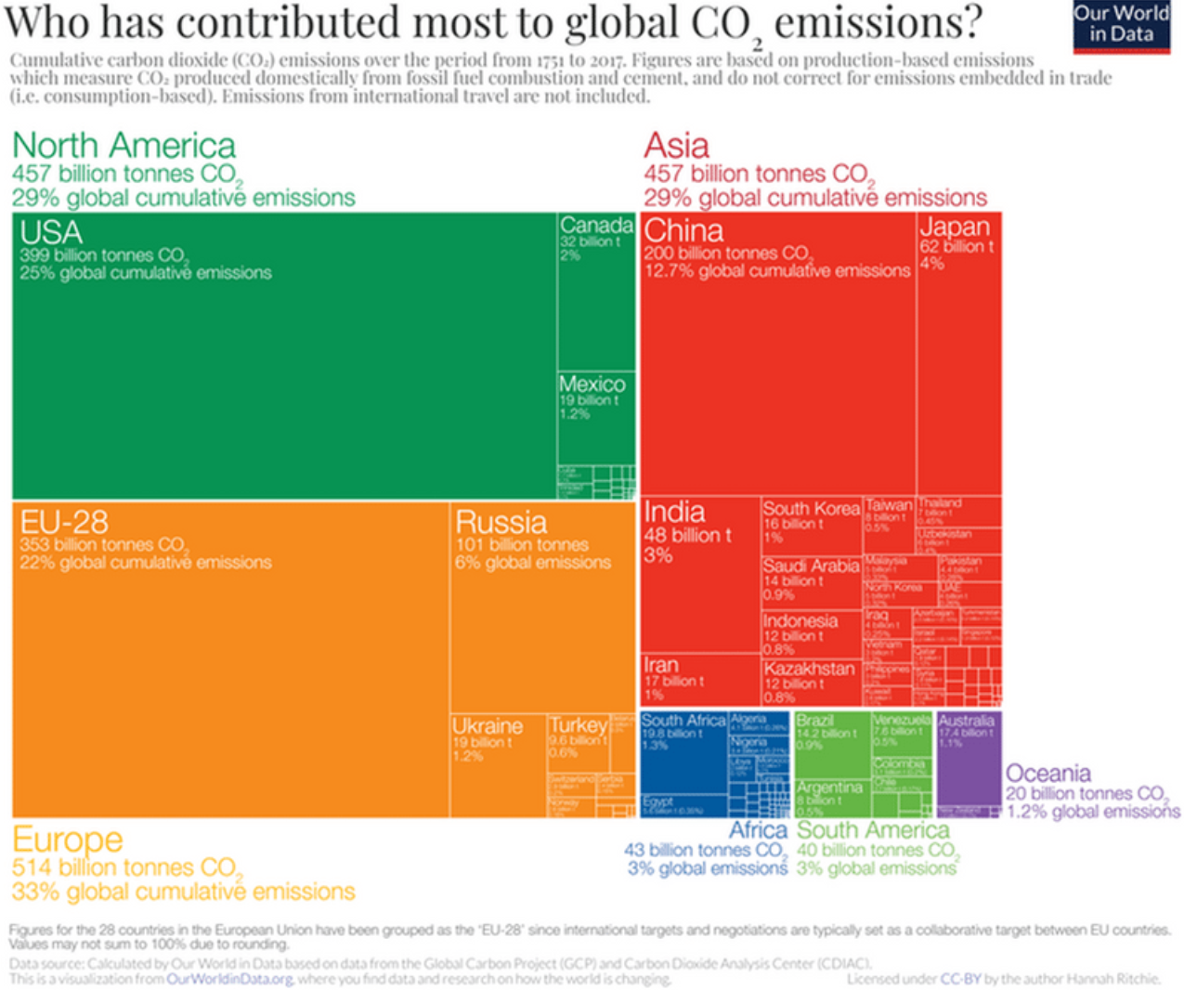
Equity & Justice
Those who contribute the least, face some of the most severe consequences of environmental change
In 2019, Africa produced about 1.1 metric tons of carbon dioxide emissions per person, well below the global average of 4.7. The US produced 16.1 metric tons per capita

Slide 10
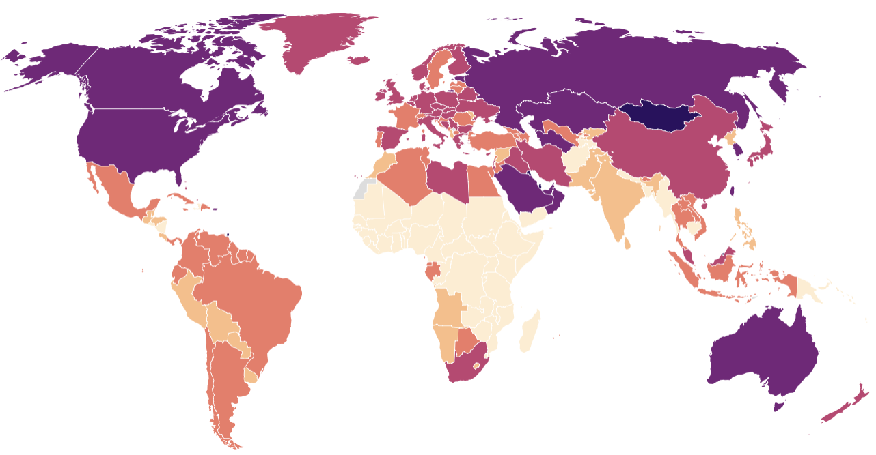
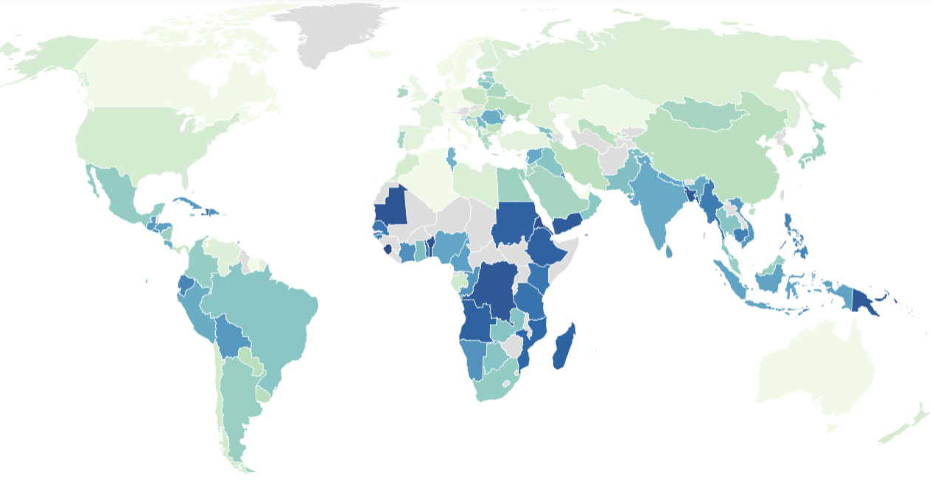
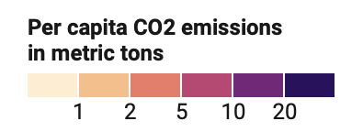
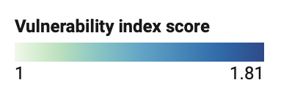
The countries most vulnerable amid climate change
Scientists assessed countries' vulnerability based on food security, water availability, human health and living conditions, ecosystem services, and infrastructure, including energy. The most vulnerable are in sub-Saharan Africa.
Data from 2019, production-based CO₂ only, does not account for emissions embedded in traded goods. Map: The Conversation/CC-BY-ND Source: Our World In Data, Global Carbon Project
Data from 2019, vulnerability rises with higher scores. Data not available for regions in grey. Map: The Conversation/CC-BY-ND Source: Edmonds, Lovell and Lovell, 2020
Notes:
Examples of Inequity:
Geographical Vulnerability
Fewer Resources to Adopt to Climate Change
Displacement and Migration

Slide 11
The Ecological Paradox Revisited
We have been borrowing against the health of future generations to realize economic and development gains in the present
Human Health & Well-Being
Ecological Health & Well-Being
Rockefeller Foundation – Lancet Commission on Planetary Heath, 2015

Slide 12
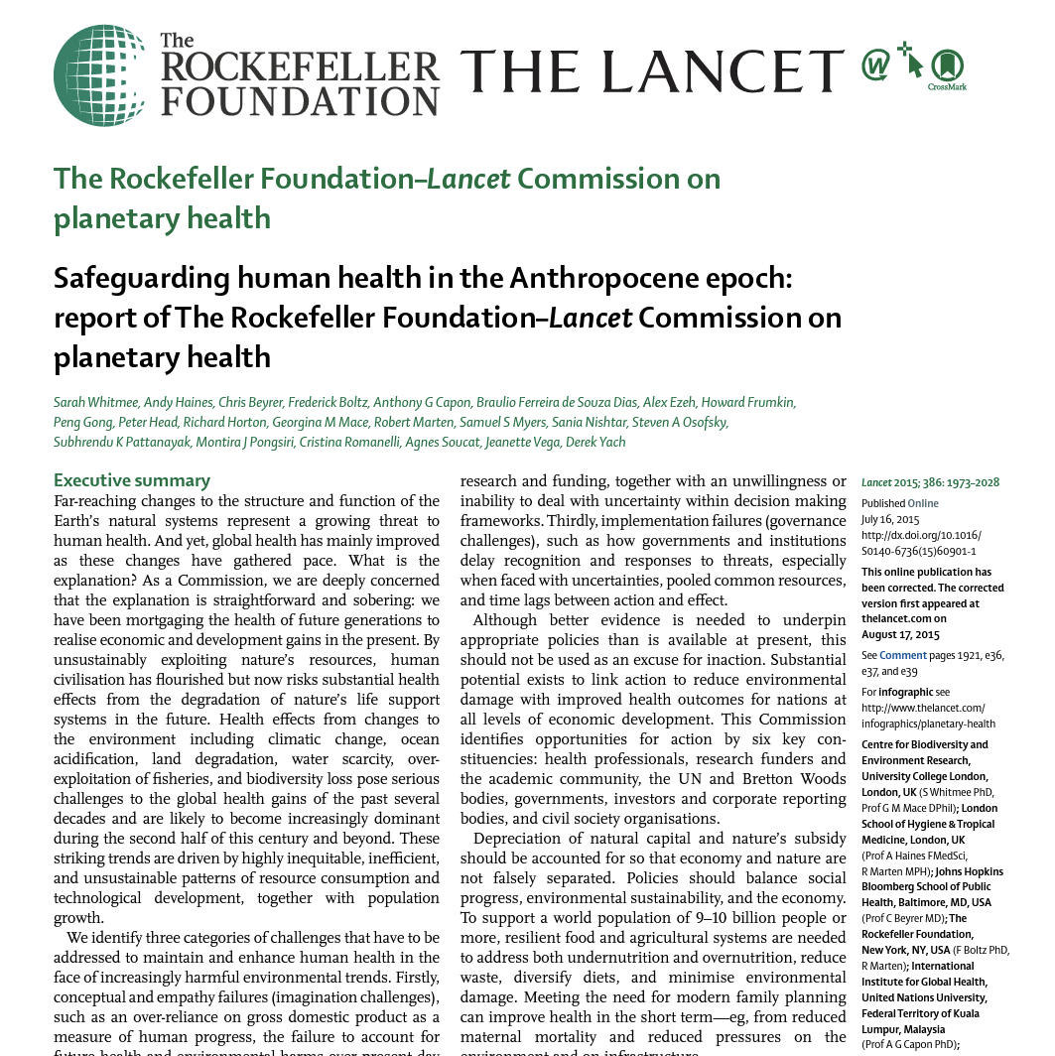
Planetary Health
A solutions-oriented, transdisciplinary field and social movement focused on analyzing and addressing the impacts of human disruptions to Earth’s natural systems on human health and all life on Earth.

Slide 13
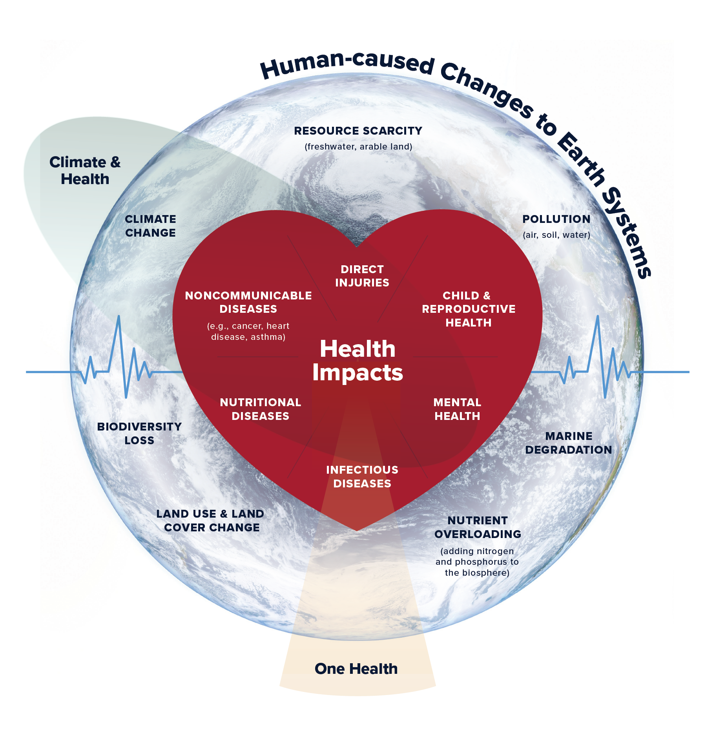
Ecological Determinants of Health
Credit: Planetary Health Alliance, 2025

Slide 14
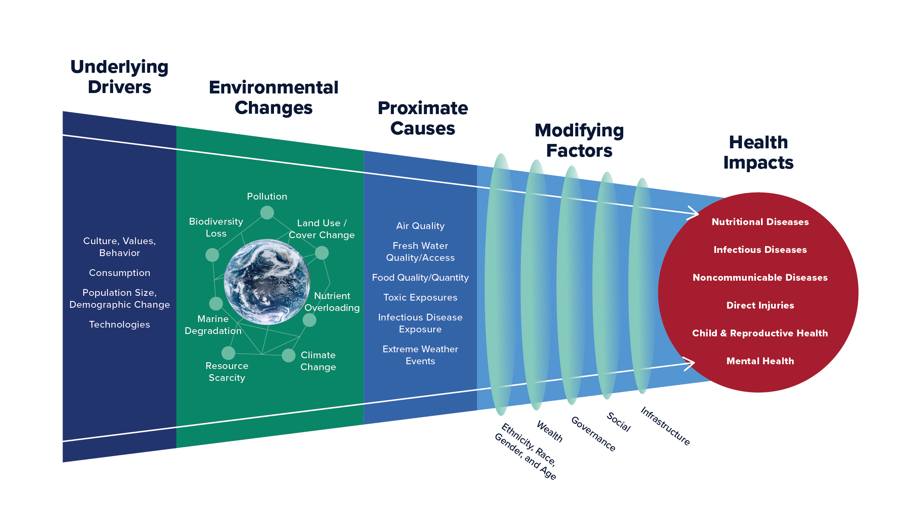
Impacts of Anthropogenic Change on Human Health
Credit: Planetary Health Alliance, 2025
Notes:
TO RECAP: We’re transforming nature at unprecedented rates, all of our systems (Drivers). All these changes interact to affect the foundational conditions for human health. As a result, seeing changes in all dimensions human health.​
Schematic illustrating impacts of anthropogenic change on human health​
Modified by Faerron Guzman from Myers, S.S., 2017. Planetary health: protecting human health on a rapidly changing planet. The Lancet, 390(10114), pp.2860-2868.)​
​
1. Human activities are driving changes to Earth's natural systems at unprecedented rates. These changes are driven by deep technological, consumption, and demographic shifts that increase the use of resources globally. These underlying drivers of change occur at large scales and transform our natural systems, changing fundamental conditions for human health and well-being. All of this is underpinned by societal value systems, codified in our socio-economic systems, that drive change and worsen the habitability of the Earth.
2. These natural systems’ changes are taking place across the following Earth systems: disruption to the global climate system; widespread pollution of air, water, and soils; rapid biodiversity loss; reconfiguration of biogeochemical cycles, including that of carbon, nitrogen, and phosphorus; pervasive changes in land use and land cover; resource scarcity, including that of fresh water and arable land; and biophysical ocean changes, including increases in temperature and acidity of the oceans.
3. These changes interact with each other in complex and sometimes uncertain ways, altering the quality of the air we breathe, the water we access, and the food we can produce. Changing environmental conditions also alter our exposure to infectious diseases, harmful substances, and natural hazards such as heat waves, droughts, floods, fires, and tropical storms. How some of these natural system changes affect our health is still unknown.
4. At the core of the analysis of how anthropogenic changes to Earth’s natural systems affect human health is the use of eco-social determinants of health frameworks that allow an understanding of complex pathways connecting root causes of global environmental change with health outcomes.
5. These changes in our planet and our lives affect every dimension of our health and well-being, including nutritional outcomes, infectious disease, non-communicable disease, displacement and conflict, and mental health outcomes.
WHAT YOU ARE LOOKING AT HERE IS THE PH FRAMEWORK FOR THINKING ABOUT THE IMPACTS OF ANTHROPOGENIC CHANGE ON HUMAN HEALTH
​
Overall, the PH framework is very useful in that it provides a unified lens to see that all of our planetary emergencies - whether they are driven by global pollution, land use change or climate change - are linked together, intersect in complex ways, and revolve around social justice and human survival. ​
​
We know that the costs of action are far lower than the costs of inaction. ​
​
We have many of the tools we need to respond to the Planetary Emergency while other new tools, methodologies and ways of relating to each other and the planet still need to be figured out. ​
​

Slide 15





The Great Transition
How we manage our natural landscapes and resources
How we construct and live in our cities
How we design our policies and build communities of practice
Achieving Planetary Health
Requires learning to do nearly everything differently, such as:
How we produce and consume food, manufactured products, and energy
The stories we tell ourselves about our place in the world, our relationship to Nature, and what it means to live a good life

Slide 16
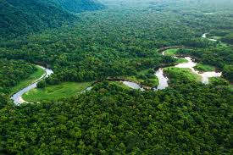
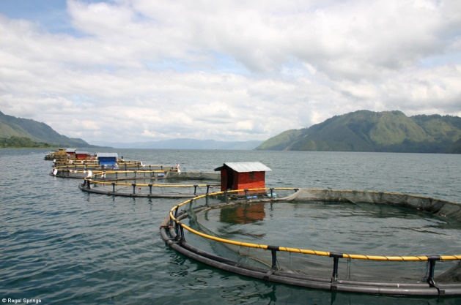
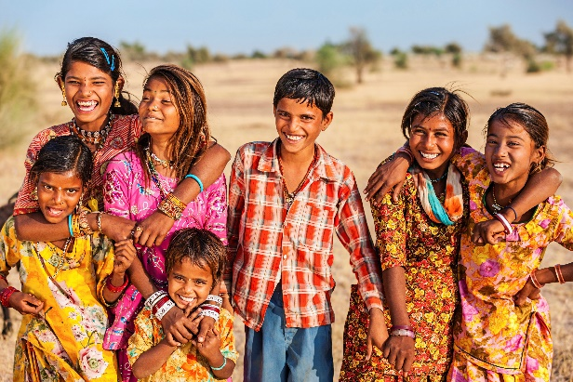
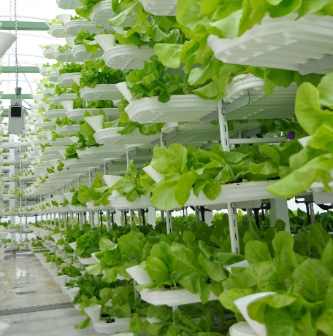

The Great Transition Solutions
Innovation and Technology (energy, food, built environment, manufacturing, chemistry, etc.)
Policy, Law, International Agreements
Private Sector (subsidies, incentives, regulations)
Movement Building/Organizing
New Narratives and Social Justice

Slide 17
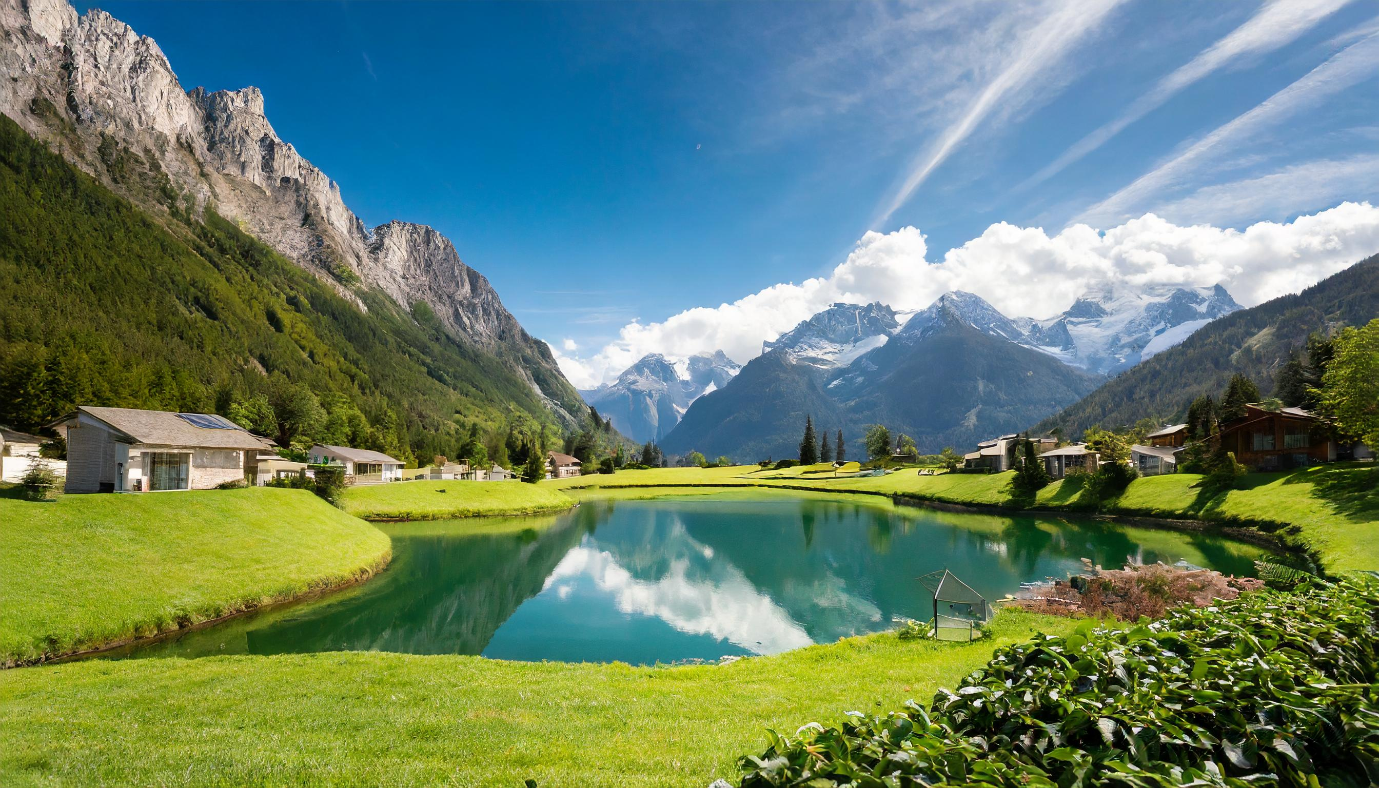
  Hope and Urgency in Collective Action
  Building a Positive Vision
  Reconnecting with Nature
  Shared Values and Ethics
Notes:
Our world faces unprecedented challenges, from climate disruption to biodiversity loss, threatening human health and well-being. We must recognize the power of collaboration in addressing these challenges and shaping a sustainable future. Collective action harnesses diverse perspectives, resources, and expertise to tackle complex issues that no single entity can solve alone.
Together, we can envision a future where humans thrive in harmony with nature, where cities are designed for sustainability, and where there's room for the entire biosphere to flourish.
As we navigate these challenges, let's rekindle our reverence for the natural world and recognize the intrinsic value of preserving it for future generations.
It's time to reaffirm our collective values and ethics, guiding our decisions towards a more equitable and sustainable world.
The future outcomes depend on the actions we take today. Let's act with urgency and determination to shape a better tomorrow for all and set examples for those who follow.

Slide 18
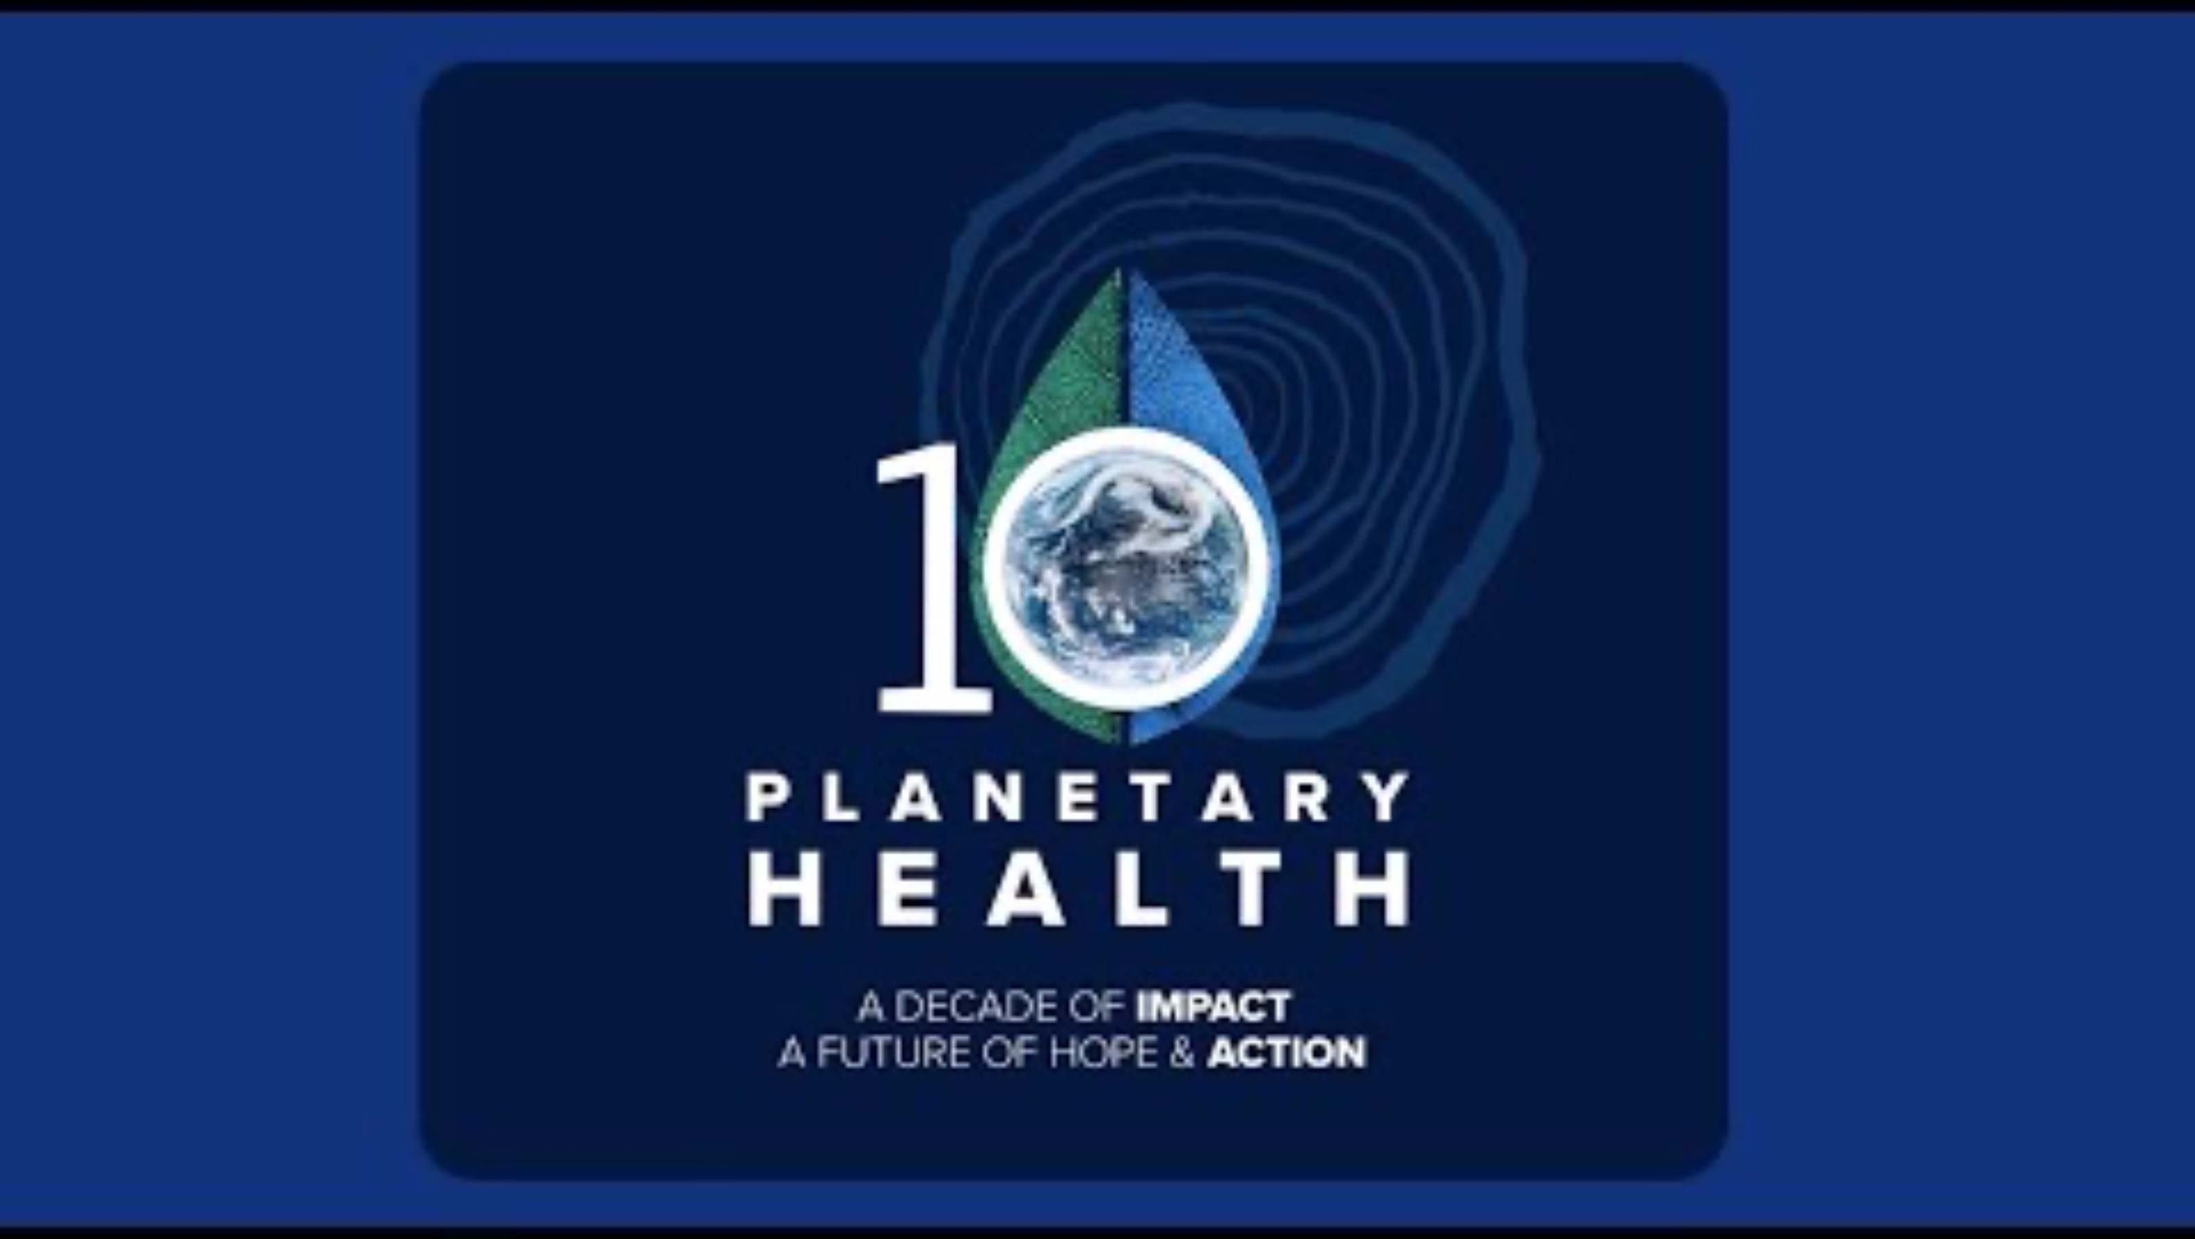

Slide 19
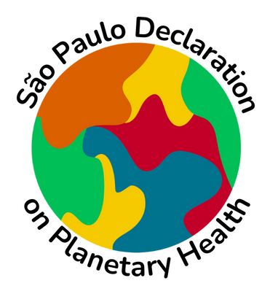
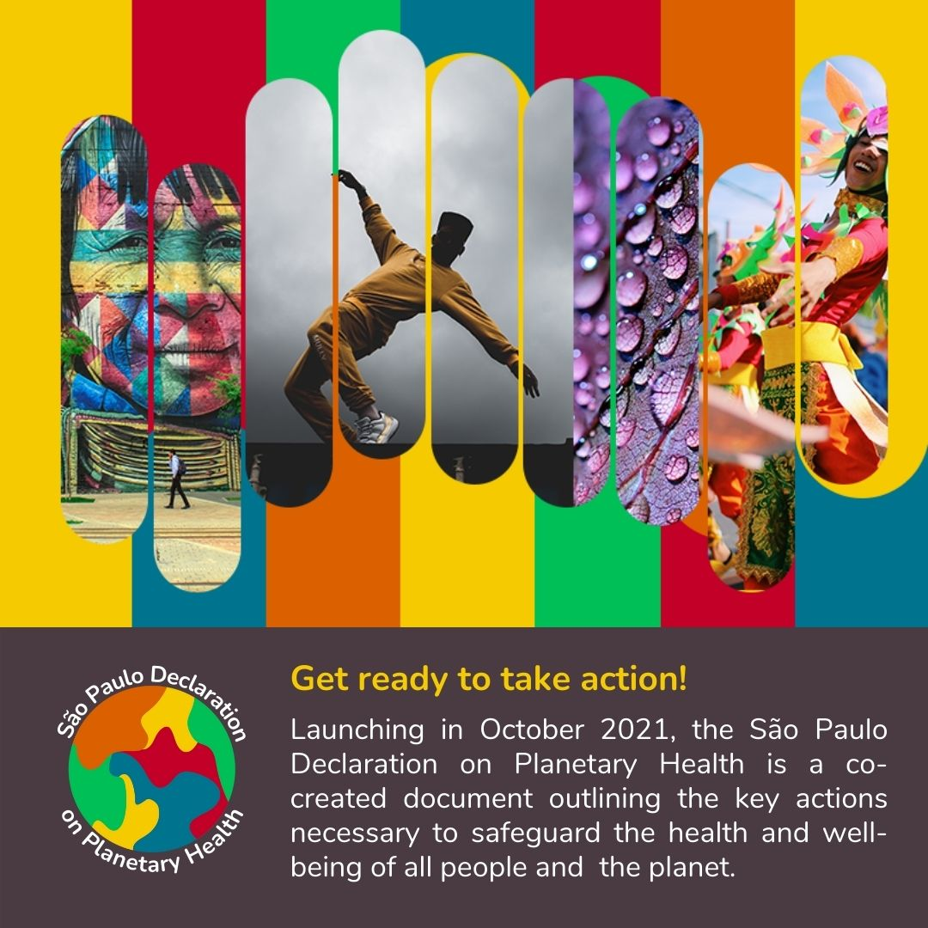
São Paulo Declaration on Planetary Health
October 2021
  Published in The Lancet, in October 2021 the Declaration includes concrete actions for 19 stakeholder groups that support a more just and regenerative post-pandemic world.
    Groups include Cities and Urban Planners, Governments, Funders, Media, Researchers, Youth Representatives
  Developed by the global Planetary Health community, including over 300 people from 70+ countries via a United Nations Development Programme (UNDP) global consultation.

Slide 20
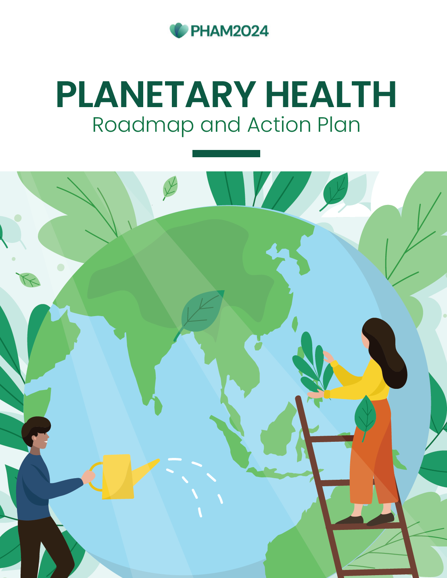
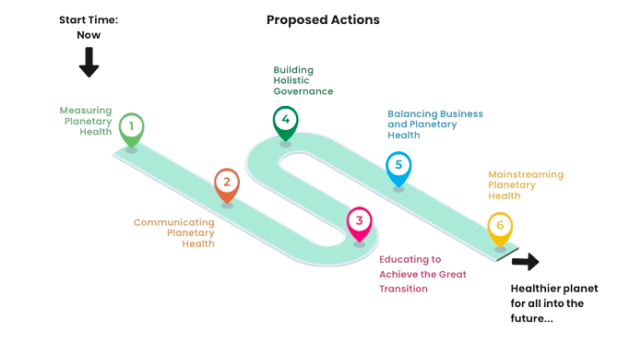
The Planetary Health Roadmap & Action Plan

Slide 21
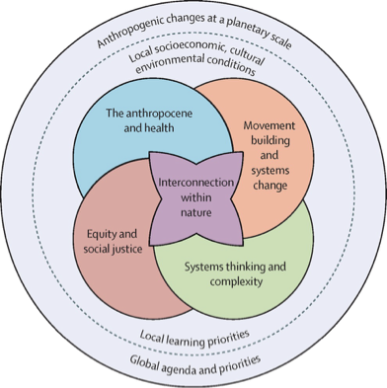
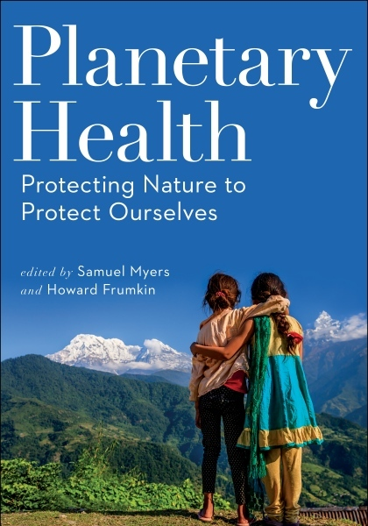
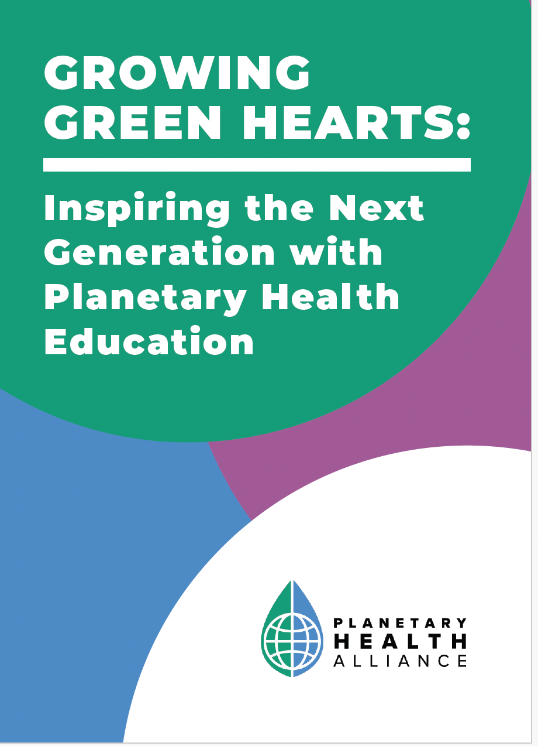
Planetary Health Education
The Lancet Planetary Health
Volume 5 Issue 5 Pages e253-e255 (May 2021)
DOI: 10.1016/S2542-5196(21)00110-8

Slide 22
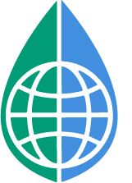
The Planetary Health Alliance
33K
Community-building, research, education, mainstreaming, and action
A diverse, inclusive community
4,500+
Individual Members
Committed to understanding and addressing the health impacts of global environmental change
500+
Organizational Members
80+
Countries

Slide 23
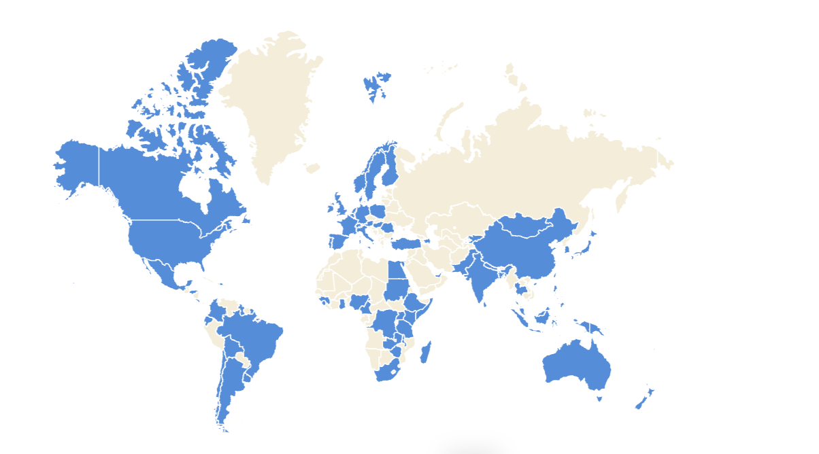
PHA Member Countries
Notes:
As of Jan 8 2025

Slide 24
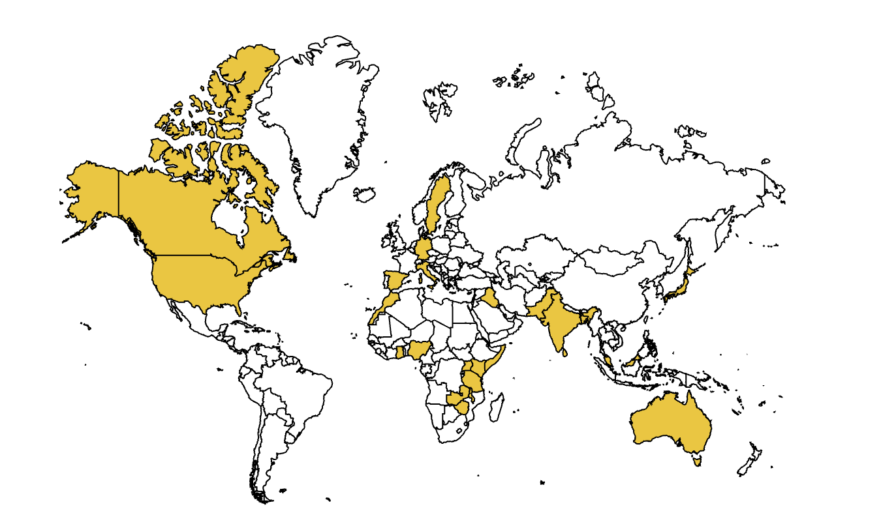
PHA Campus Ambassadors
Notes:
*As of Jan 1, 2025

Slide 25






Join the Planetary Health Alliance
Collaborate with over 500 organizations from 80+ countries committed to understanding and addressing Planetary Health: the human health impacts of global environmental change.
How to get involved:
Sign up for our monthly newsletter
Follow us on social media: @ph_alliance
Youth: Join our Next Gen Network or PHCA program
Join as an individual or organization
Find your Regional Hub
PlanetaryHealthAlliance.org
Community Building
Policy
Education
Research
Action

